Slide 1
Context Information: Payoff Data
Cognitive Process
Heuristics?
Part of Heuristics?
EIPs!
Translation Metric
unobservable
observable
MBTs!
Mouse Movement
Task Information: Time Limit, Complexity
Strategic Decision Task: Normal Form Games
Human Decision Maker
Decision

Slide 2
Strategic Decision Task: Normal Form Games
Human Decision Maker
Decision
Context Information:
Payoff Data
Task Information:
Time Limit
Complexity
Mouse Movement
observable
unobservable
Translation Metric
Cognitive Process

Slide 3
Human
Decision Maker
Behavior:
Mouse Movement (MBTs*)
Strategic Decision Task: Normal Form Games
Decision
Context Information:
Payoff Data
Task Information:
Time Limit
Complexity
observable
unobservable
Translation Metric:
MBTs : EIPs**
Cognitive Process:
EIPs
(Part of) Heuristics?
Study Contribution
* Motoric Basic Tasks
** Elementary Information Processes

Slide 4
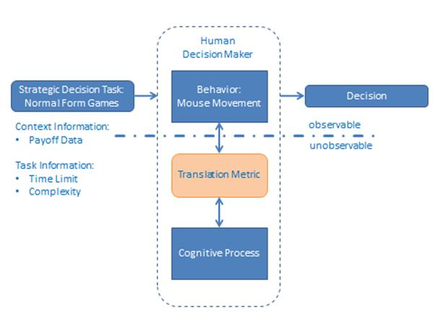

Slide 5
Simulation of Human
Decision-Making Process
Input: Strategic Decision Tasks (Normal Form Games)
Behavior:
Heuristics
Output:
Decision
Simulation
a. Context Variable:
Payoff Data
b. Task Variables:
Time Limitation
Complexity
c. Random Variables:
Choice
Starting Focus
Starting Point
EIP-Patterns & Heuristics Performance
Evaluation:
Effectivity
Efficiency
Production System
Cognitive Process:
EIPs*
Legend
Study Contribution
Elementary Information Processes
*

Slide 6
Game
=
Players
Alternatives & payoff matrix
+
Time limit
+
Simulation
Heuristics‘ production systems
complexity, game type, player type
+
EIP limit
=
+
Results
Chosen alternative player r
Number EIP & types EIP
+
Realized payoff
=
+
Chosen alternative player c

Slide 7
Human
Decision Making Process
Input: Strategic Decision Tasks: Experimental Normal -Form Games
Behavior:
Mouse Movement
(EMMAs*)
Output: Decision
Evaluation:
Effectivity
Efficiency
Experiment
a. Context Variable:
Payoff Data
b. Task Variables:
Time Limitation
Complexity
Interpretation Metric
EMMAs : EIPs
observable
unobservable
Cognitive Process:
EIPs**
Legend
Study Contribution
Elementary Manual Motor Acts Elementary Information Processes
*
**

Slide 8
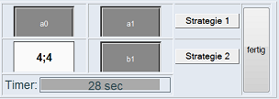
play
store data
User
Online experiment
provide files
extract by script
Server
Data table

Slide 9
Game
Two Players
Alternatives & payoff matrix
Time limit
+
+
Simulation
Heuristics‘ production systems [1…9]
Complexity [2…5],
game type [1…11],
player type [row, column]
EIP limit [3…1200,3]
+
+
Results
Numbers & types of EIP
Heuristic-specific EIP patterns
Chosen alternative & realized payoff
+
+
Heuristics‘ production systems
applied to
Game
until reach
EIP limit or end of production system
measure
determine
EIP sequence
EIP Numbers & types & patterns

